Slide 1

Boosting

Slide 2

Contents
Ensemble Learning
Success Stories
Bias vs variance
Trade-off
Boosting
Adaboost & Gradient Boosting
03

Slide 3
Ensemble Learning
An Ensemble is a set of multiple weak classifiers that learn a target function.
A Complex problem can be decomposed into multiple sub-problems that are easier to understand and solve (divide-and-conquer approach)
Classifier 1
Classifier 2
Input
Ensemble
Output
Sd
Df
df
Input
Classifier N
03
Notes:
Anomaly detection is about finding what you don’t know to look for
You are searching for anomalies, but you don’t know what their characteristics will be. If you did, you could use a different form of machine learning, called classification, or you would just write specific rules to find the anomalies. But that’s not generally where you start
Most important aspect of anomaly detection: Finding what is normal
Then one can spot data that falls outside of what is normal
Anomalies are defined not by their own characteristics, but in contrast to what is normal.
looking for events that are rare relative to what is expected and that often are surprising, or at least undefined ahead of time.
s

Slide 4


Why it Works
Intuition
Combining diverse, independent opinions in human decision making as a protective mechanism (e.g. stock portfolio)
>
Uncorrelated Error Reduction
Suppose we have 5 completely independent classifiers for majority voting
If accuracy is 70% for each
10 (.7^3)(.3^2)+5(.7^4)(.3)+(.7^5)
83.7% majority vote accuracy
99.9% majority vote accuracy
101 such classifiers –
99.9% accuracy
03

Slide 5
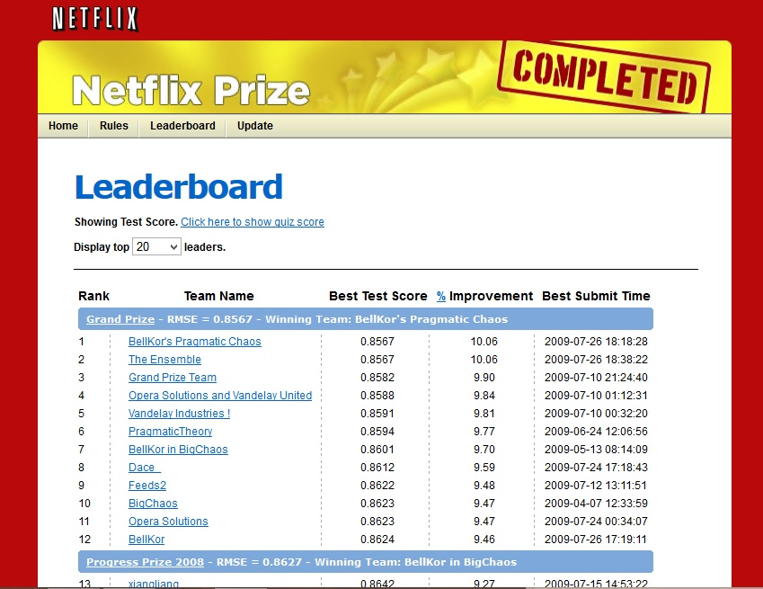
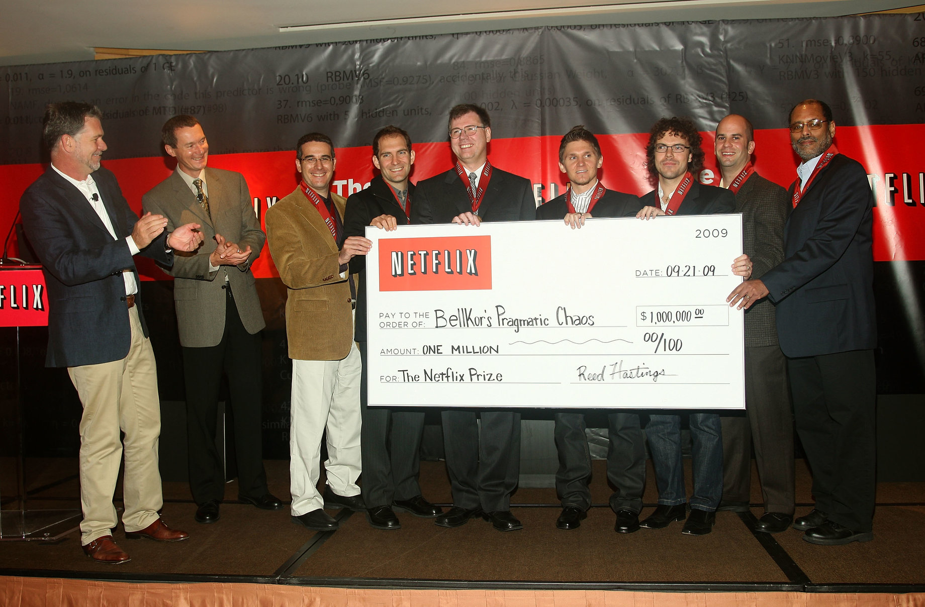
Success Stories
Netflix Million Dollar Prize
Improve baseline movie recommendation by 10% in accuracy.
Individuals and teams merged their results, and significant Improvements are observed.
Data Mining Competitions
Classification Problems
Winning teams employ an ensemble of classifiers
03

Slide 6
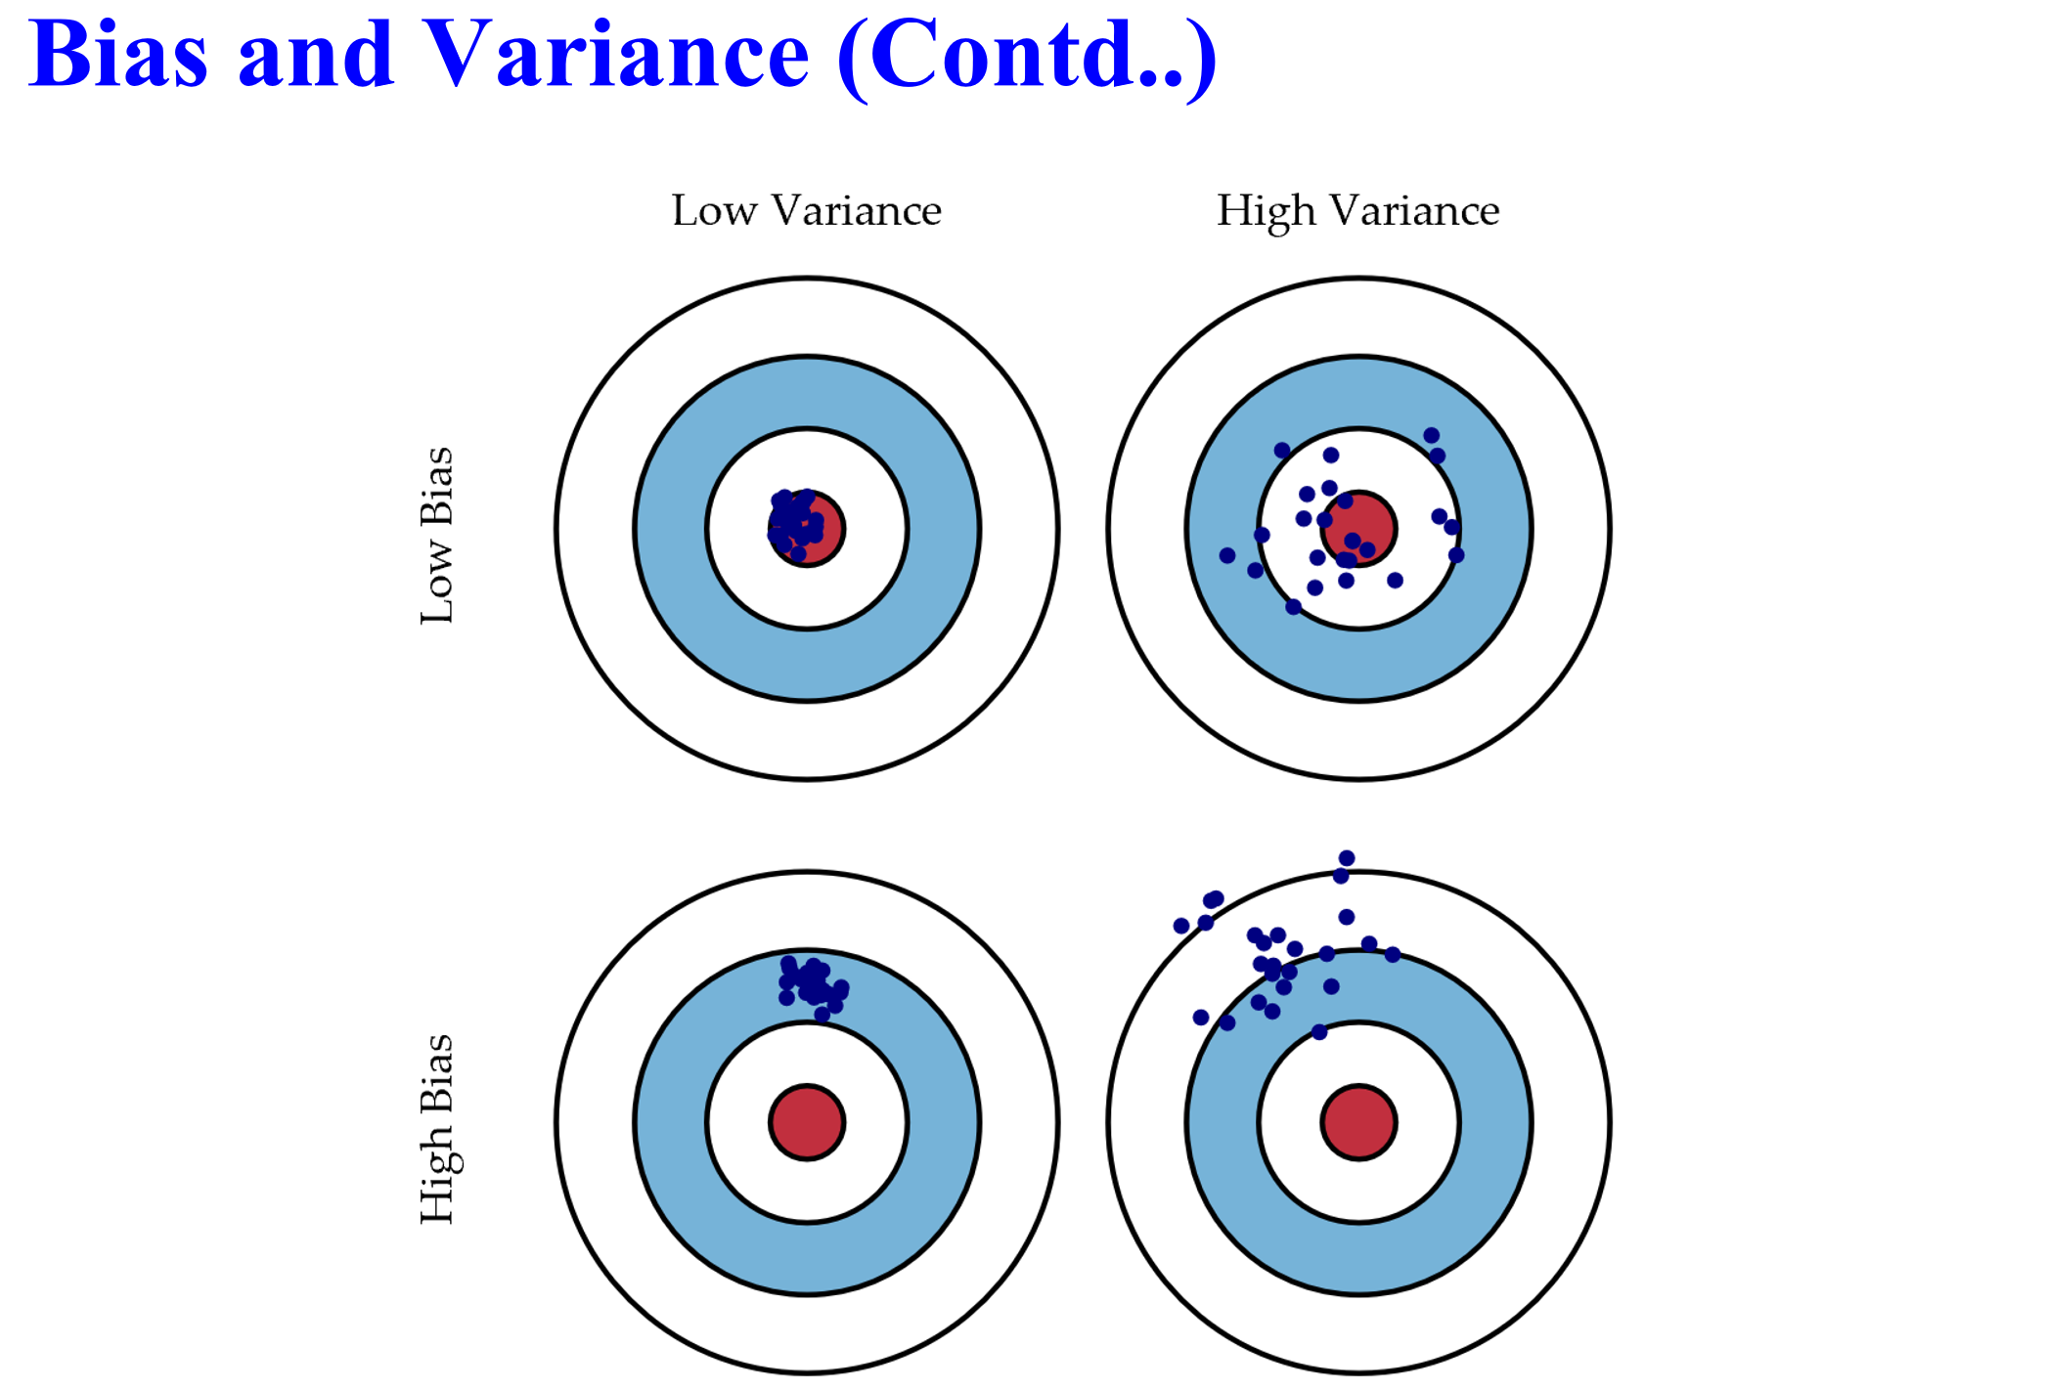
Bias and Variance
Bias
Measure the accuracy or quality of the algorithm.
High bias means poor match
Variance
Measures the precision or specificity of the match
A high variance means a weak match
We would like to minimize each of these
Unfortunately, we can’t do this independently, since there is a trade-off
03

Slide 7
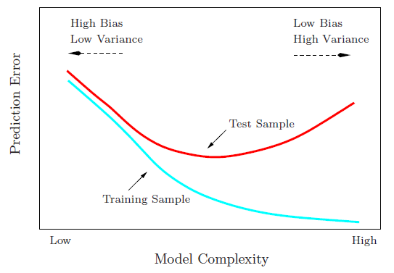

Bias vs Variance trade-off
03

Slide 8
Methods Employed
To reduce Variance
Bagging is employed
Use bootstrapping to generate L training sets and train one base-learner with each set.
Eg- Random forest
To reduce Bias
Boosting is employed
An iterative procedure to adaptively change distribution of training data by focusing more on previously misclassified records.
Eg- Adaboost, Gradient Boosting, XGBoost
03

Slide 9
AdaBoost
It is a general ensemble method that creates a strong classifier from a number of weak classifiers.
This is done by building a model from the training data, then creating a second model that attempts to correct the errors from the first model. Models are added until the training set is predicted perfectly or a maximum number of models are added.
Original Data | 1 | 2 | 3 | 4 | 5 | 6 | 7 | 8 | 9 | 10
Boosting (Round 1) | 7 | 3 | 2 | 8 | 7 | 9 | 4 | 10 | 6 | 3
Boosting(Round 2) | 5 | 4 | 9 | 4 | 2 | 5 | 1 | 7 | 4 | 2
Boosting (Round 3) | 4 | 4 | 8 | 10 | 4 | 5 | 4 | 6 | 3 | 4
Example 4 is hard to classify
Its weight is increased, therefore it is more likely to be chosen again in subsequent rounds
03

Slide 10
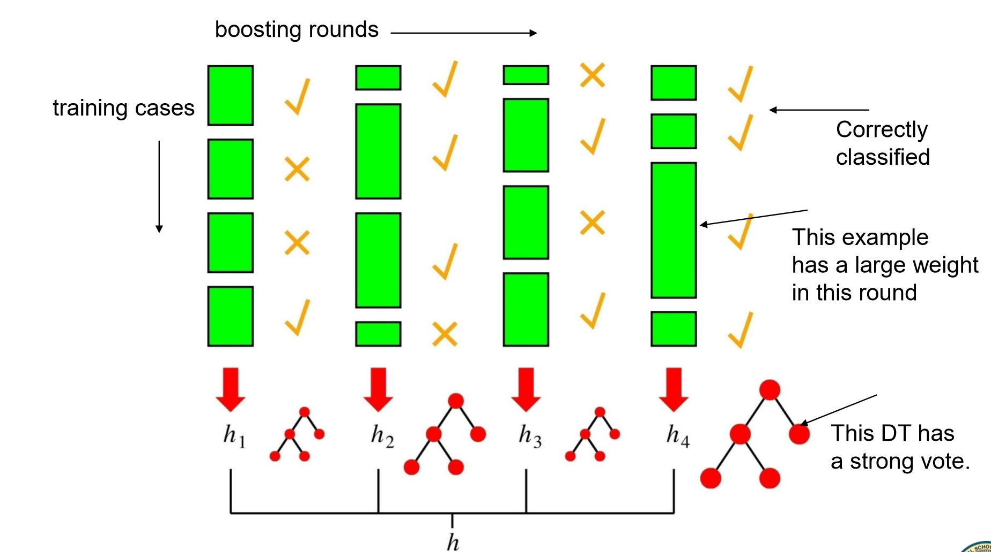
AdaBoost
Records that are wrongly classified will have their weights increased
Records that are classified correctly will have their weights decreased
Samples that are difficult to classify receive increasing larger weights until the algorithm identifies a model that correctly classifies these samples
03

Slide 11
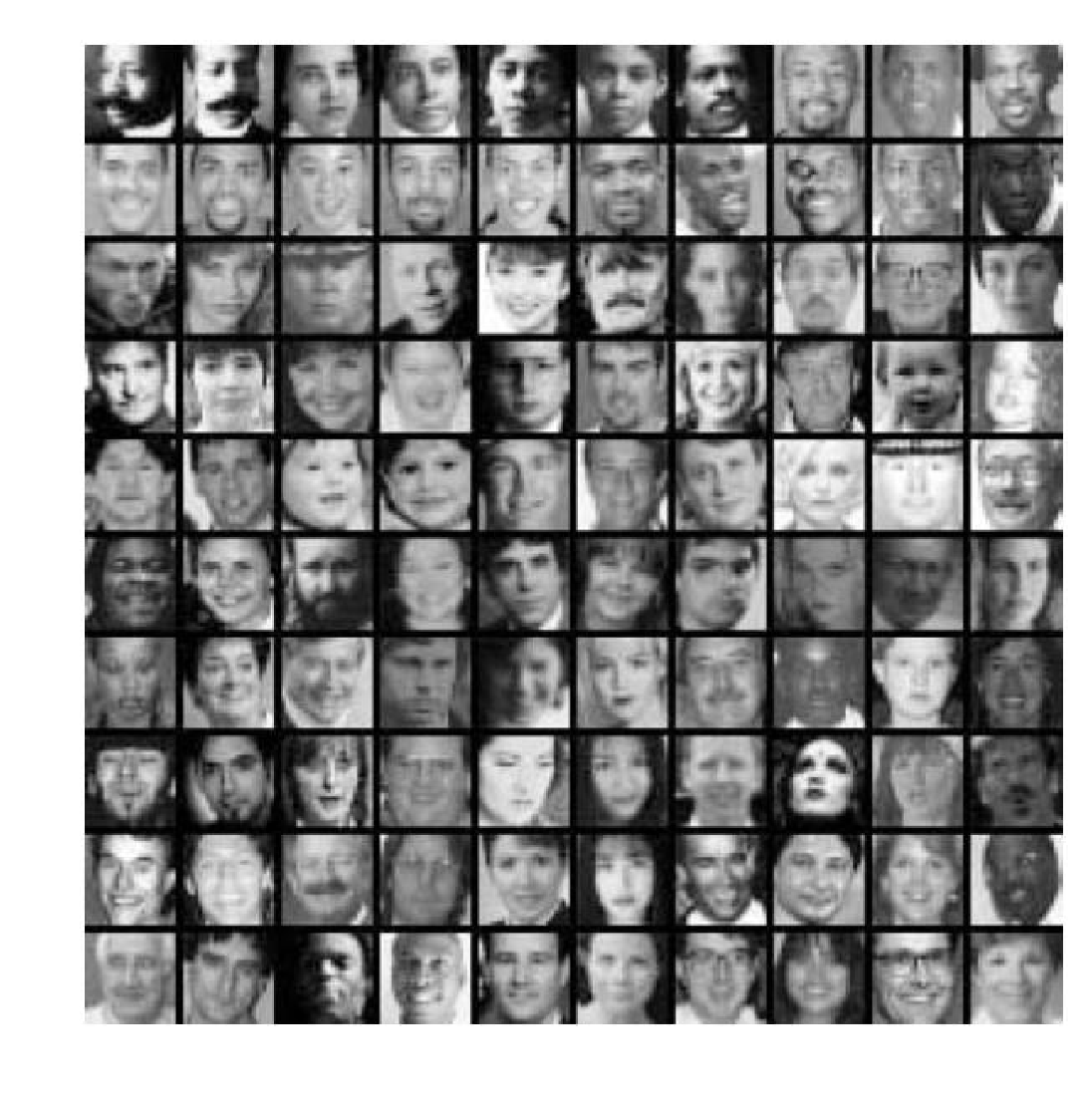
Face Detection System
Training Data
5000 faces
All frontal, rescaled to 24x24 pixels
9500 million non-faces
Faces are normalized • Scale, translation
Many Variations
Across individuals Illumination Pose
03

Slide 12
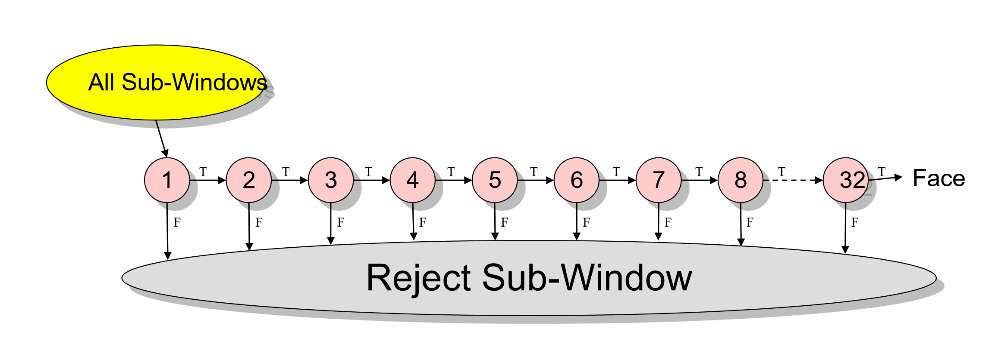
Structure of Detection Algorithm
Combining successively more complex classifiers in cascade
32 stages
Included a total of 4297 features
03

Slide 13
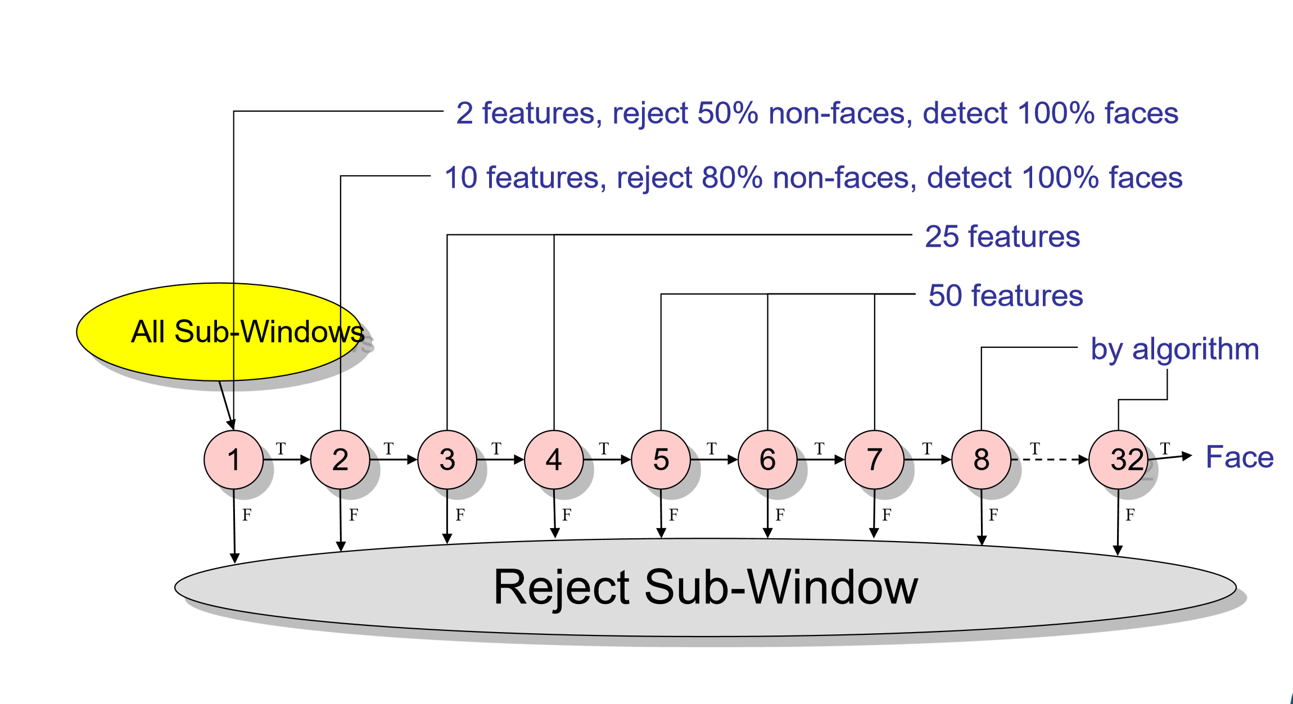
Structure of Detection Algorithm
03

Slide 14
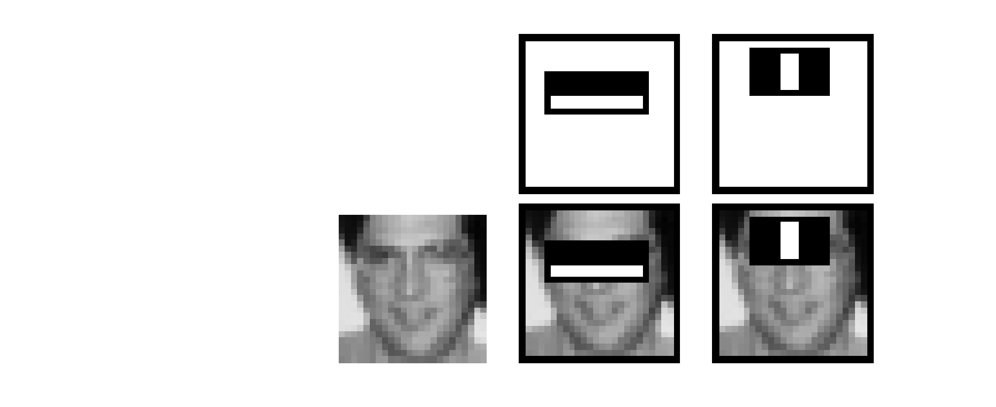
Feature Selection by AdaBoost
The first and second features selected by AdaBoost.
The two features are shown in the top row and then overlayed on a typical training face in the bottom row.
The first feature measures the difference in intensity between the region of the eyes and a region across the upper cheeks. The feature capitalizes on the observation that the eye region is often darker than the cheeks.
The second feature compares the intensities in the eye regions to the intensity across the bridge of the nose.
03

Slide 15
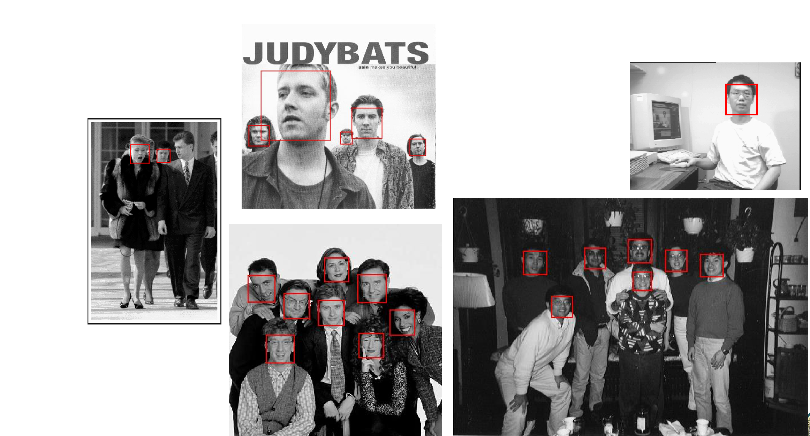
Speed of Final Detector
Test Image output
On a 700 Mhz Pentium Ill processor, the face detector can process a 384x288 pixel image in about .067 seconds
15 times faster than previous detector of comparable accuracy (Rowley et al., 1998)
Average of 8 features evaluated per window on test set
03

Slide 16
Strengths
Instead of trying to design a learning algorithm that is accurate over the entire space, we can focus on finding base learning algorithms that only need to be better than random.
Weakness
Boosting seems to be especially susceptible to noise.
It can identify outliers: i.e. examples that are either mislabeled or that are inherently ambiguous and hard to categorize.
When the number of outliners is very large, the emphasis placed on the hard examples can hurt the performance.
It has no parameters to tune (except for the number of rounds)
The actual performance of boosting depends on the data and the base learner.
03

Slide 17
Boosting
• Adaboost
–Second model is built on the samples where first model failed.
• Gradient boosting machines
–Second model is built on the error made by first model.
03

Slide 18
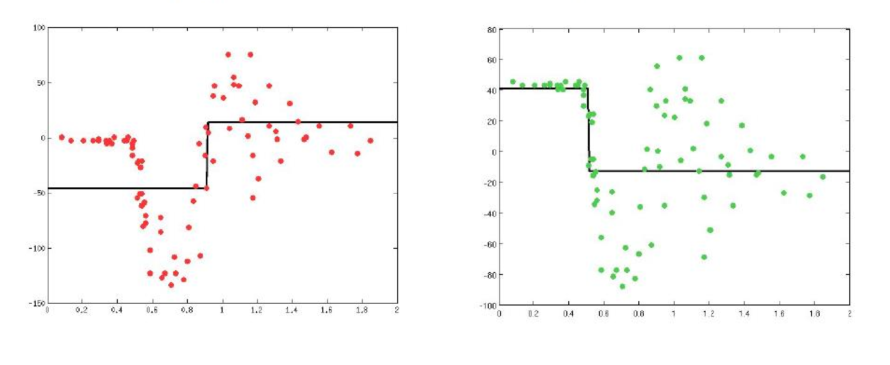
Error residual
Learn a simple predictor.. Then try to correct its errors
03
Notes:
https://www.youtube.com/watch?v=sRktKszFmSk

Slide 19
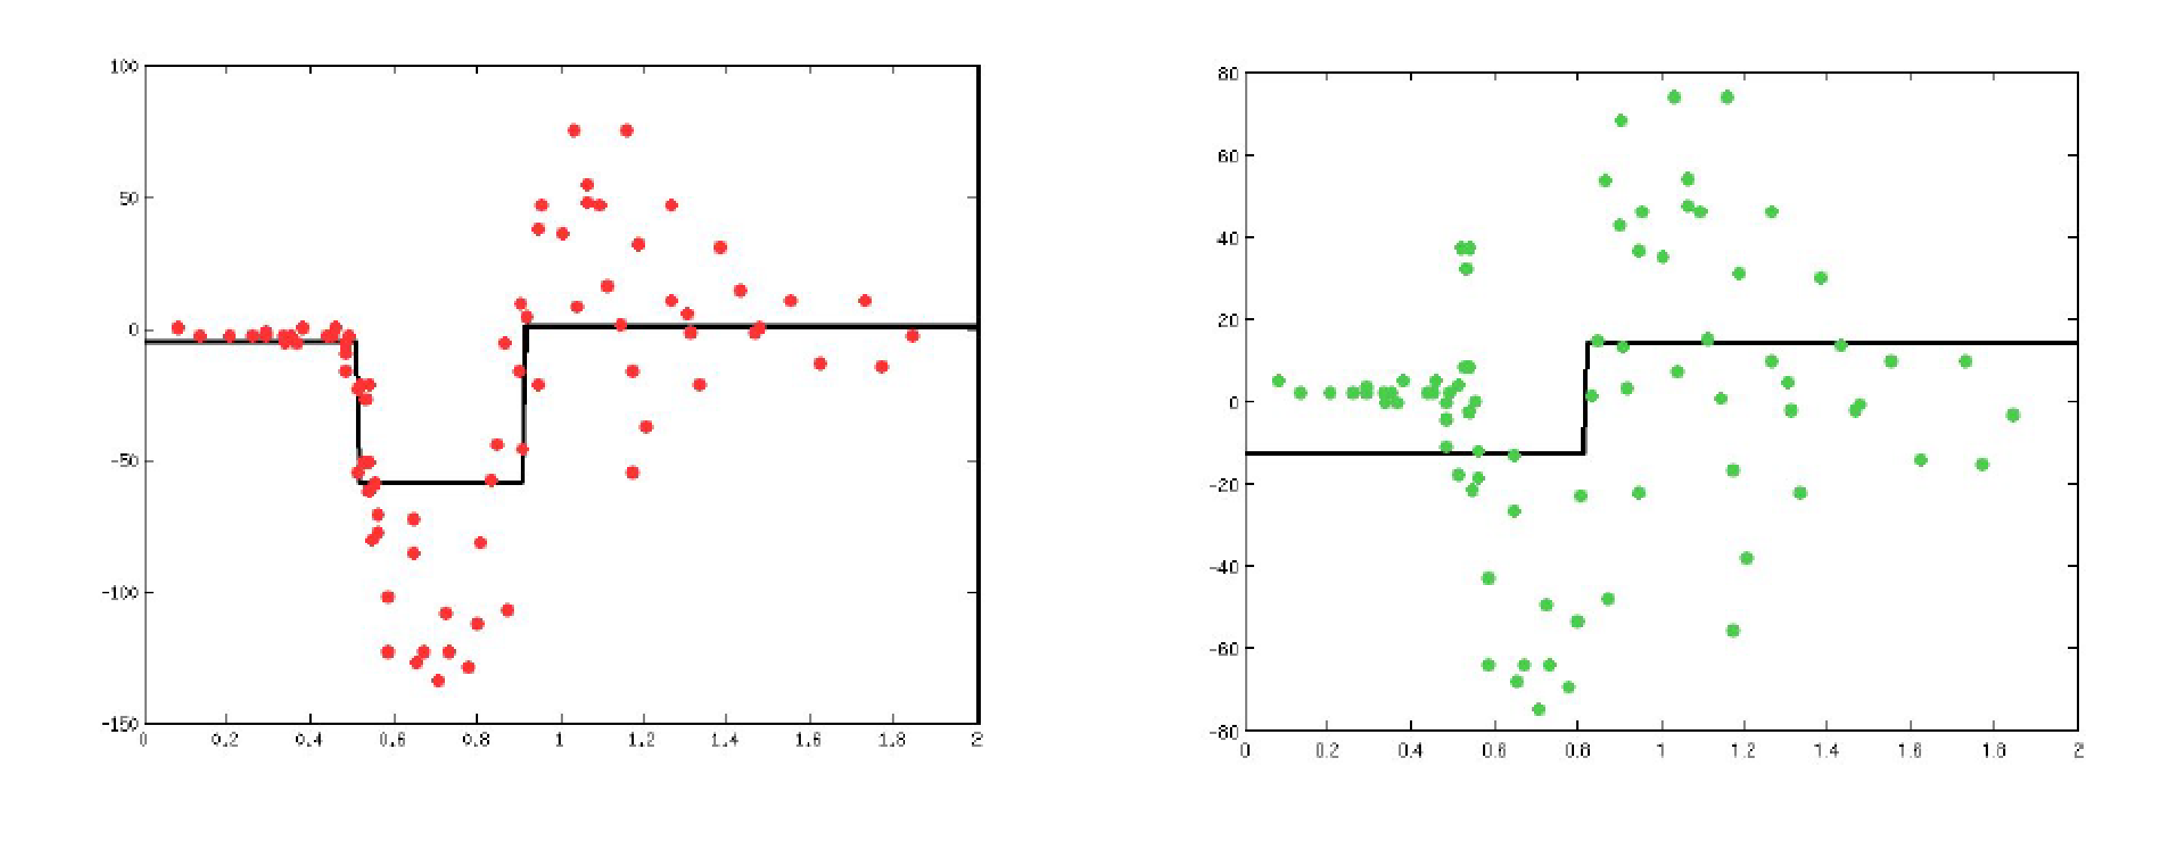
Error residual
Combining gives a better predictor… Can try to correct its errors & repeat
03

Slide 20
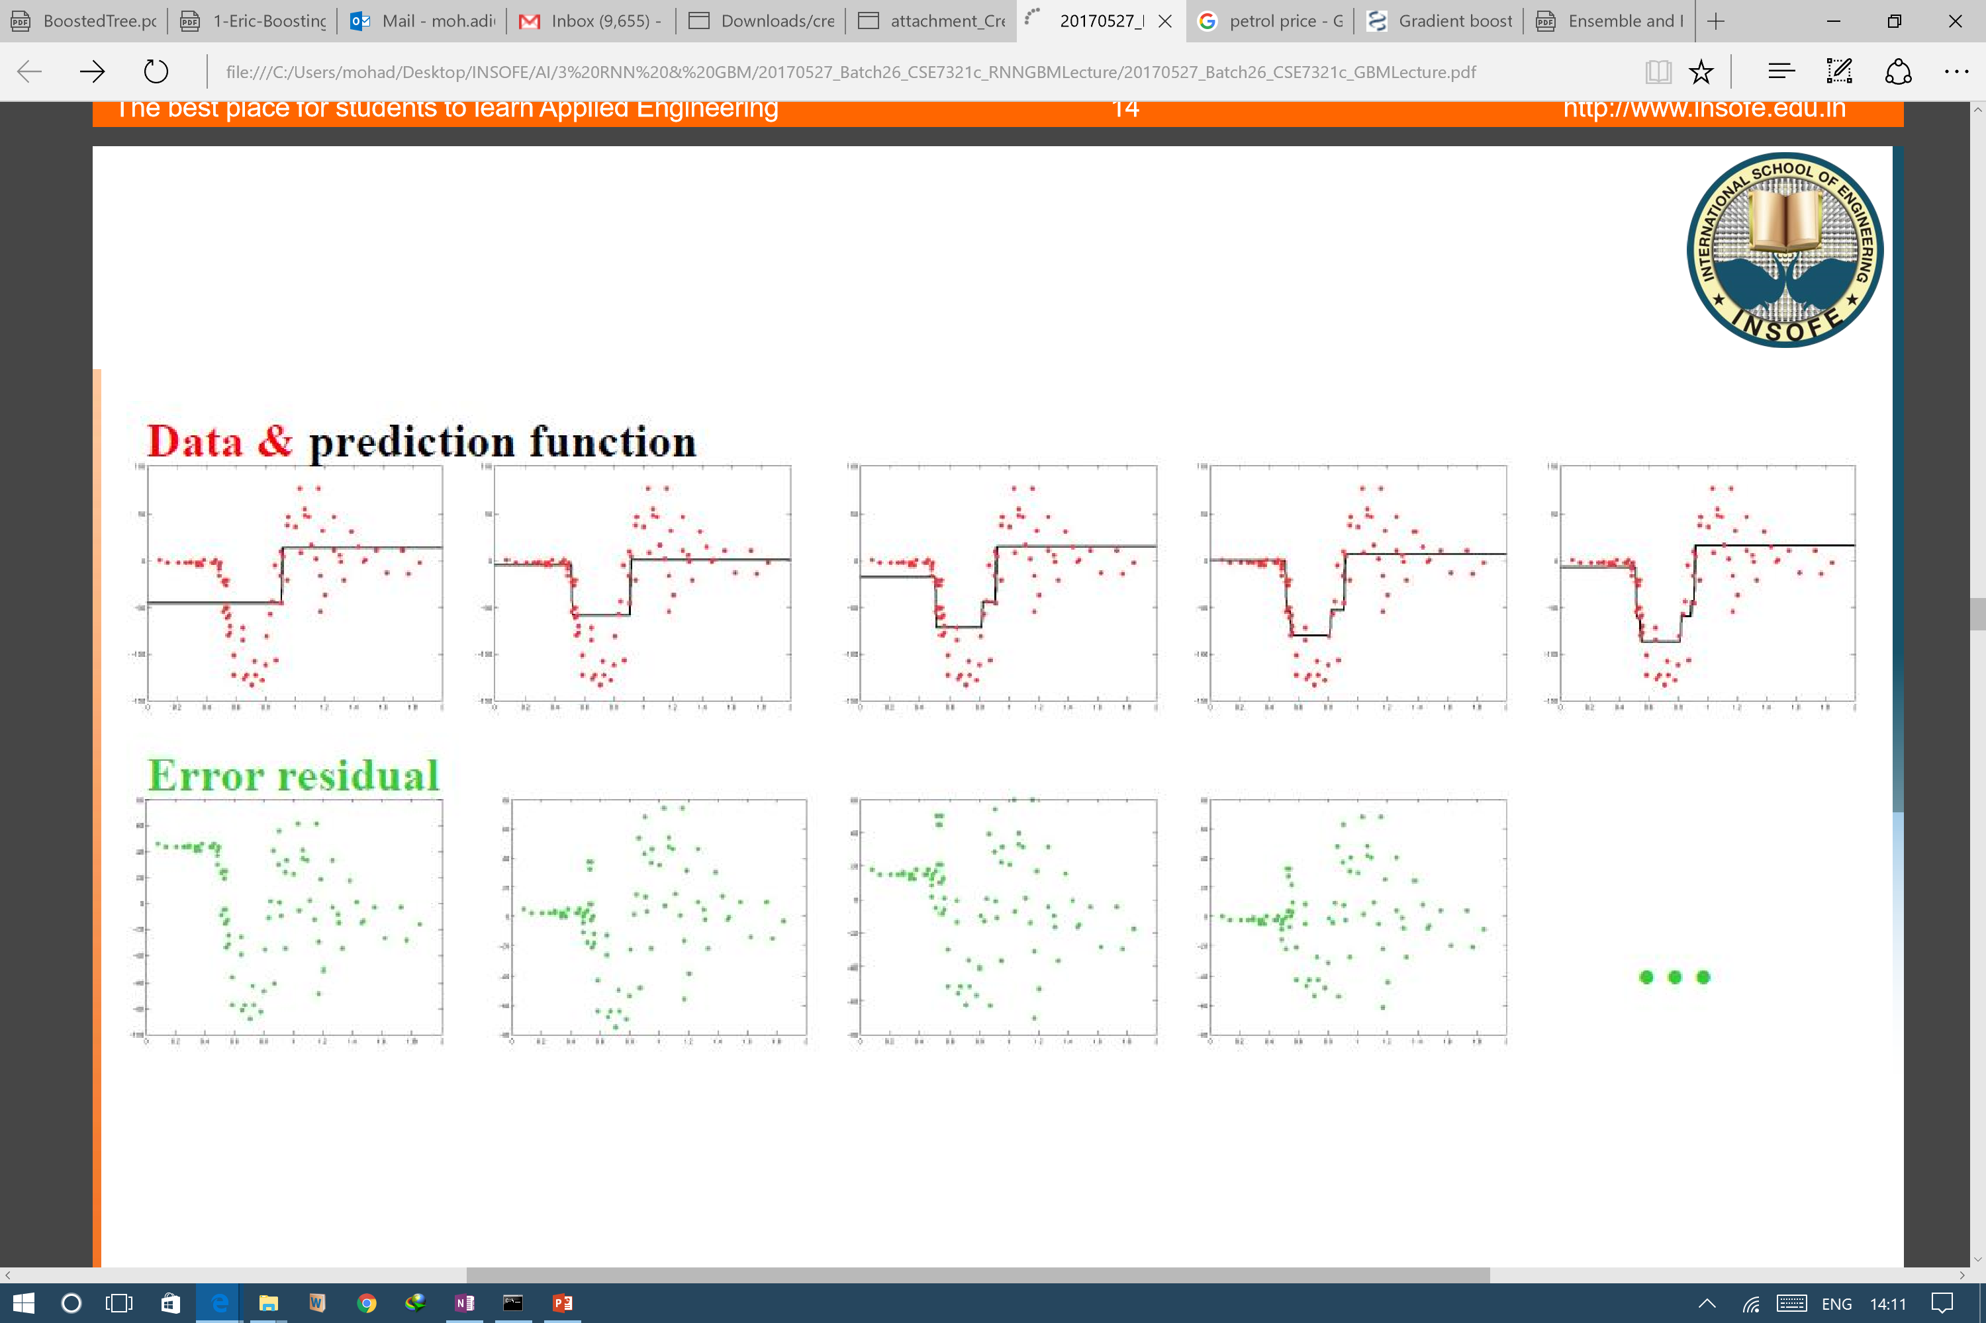
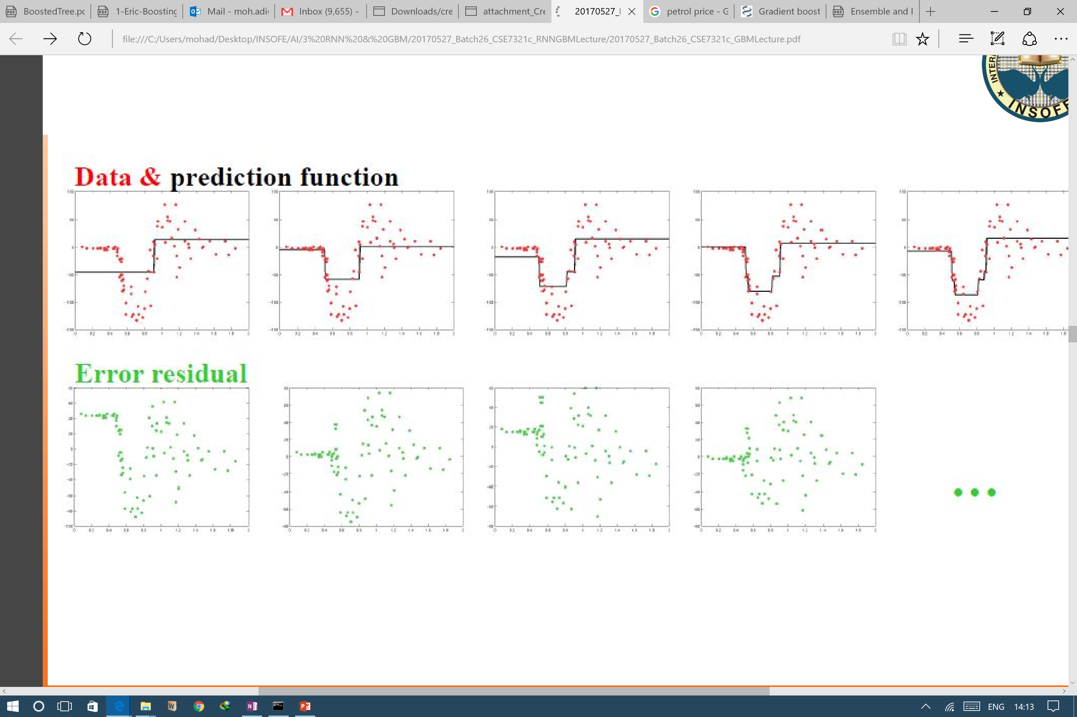
Error residual
Data and prediction function
Error residual
03

Slide 21
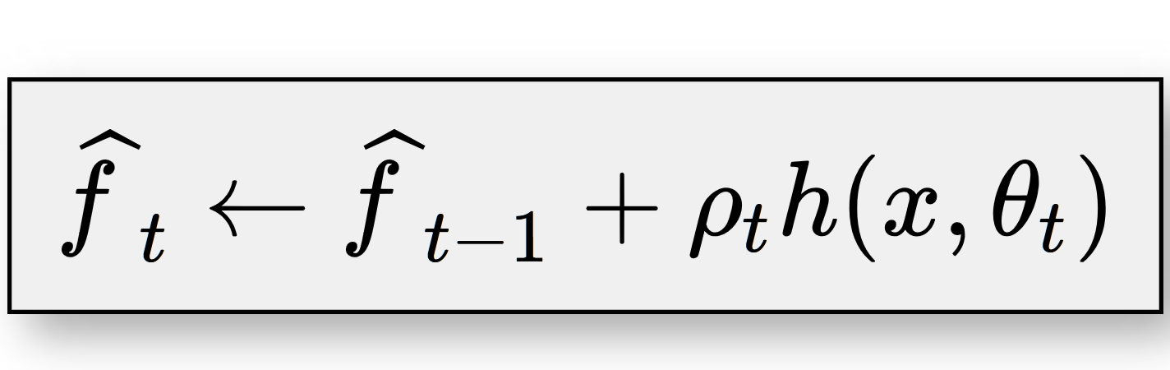
fˆt−1+ρth(x,θt)
GBM choices
Choice of the loss-function Ψ(y, f) (least squares, logistic etc.) Choice of the base-learner model h(x, θ) (regression, trees etc.)
Algorithm: 1: initialize fˆ0 with a constant
for t = 1 to M do
compute the negative gradient gt(x)
fit a new base-learner function h(x, θt)
find the best gradient descent step-size ρt:
03

Slide 22
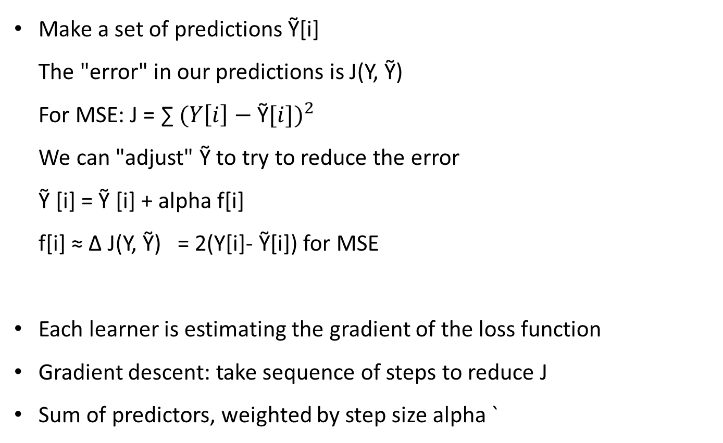
Loss Functions
Make a set of predictions Ỹ[i] The "error" in our predictions is J(Y, Ỹ) For MSE: J = ∑ ${(Y\left[i\right]−\text{Ỹ}[i])}^{2}$ We can "adjust" Ỹ to try to reduce the error Ỹ [i] = Ỹ [i] + alpha f[i] f[i] ≈ ∆ J(Y, Ỹ) = 2(Y[i]- Ỹ[i]) for MSE
Each learner is estimating the gradient of the loss function
Gradient descent: take sequence of steps to reduce J
Sum of predictors, weighted by step size alpha `
03

Slide 23
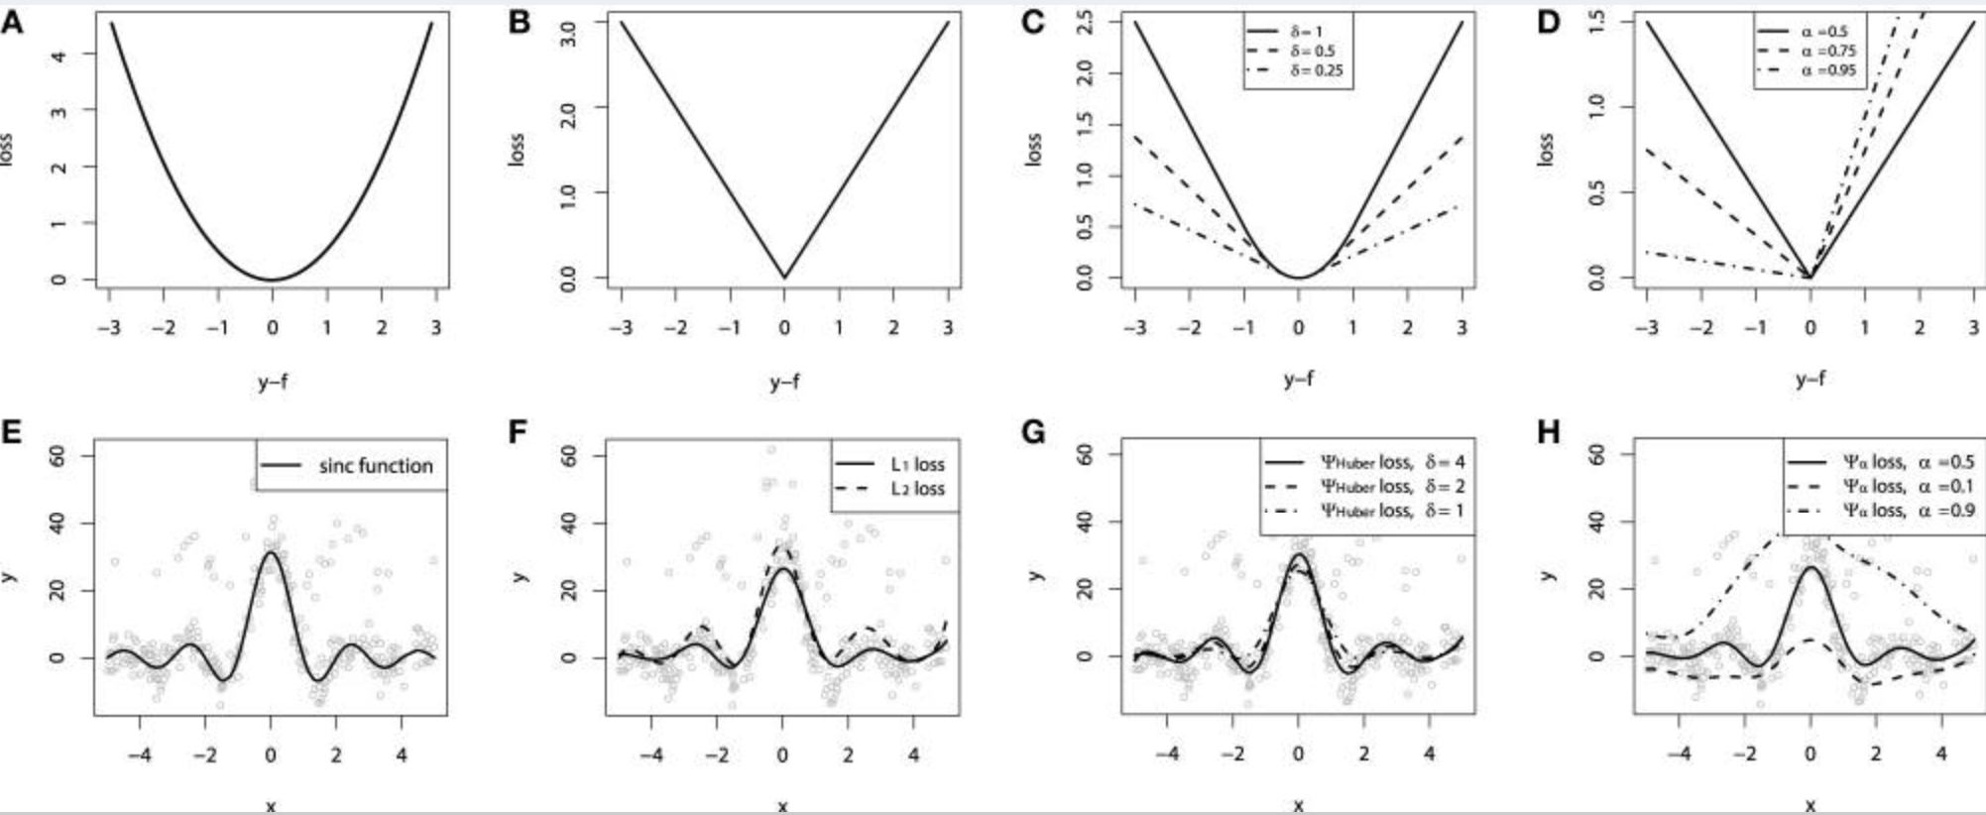
Loss function is a hyper parameter
03

Slide 24

Base Learners
• Linear models:
– Ordinary linear regression
– Ridge penalized linear regression
– Random effects
• Smooth models:
– P-splines
– Radial basis functions
• Decision trees
– Decision tree stumps
– Decision trees with arbitrary interaction depth
• Other models:
– Markov Random Fields
– Wavelets
– Custom base-learner function
03

Slide 25
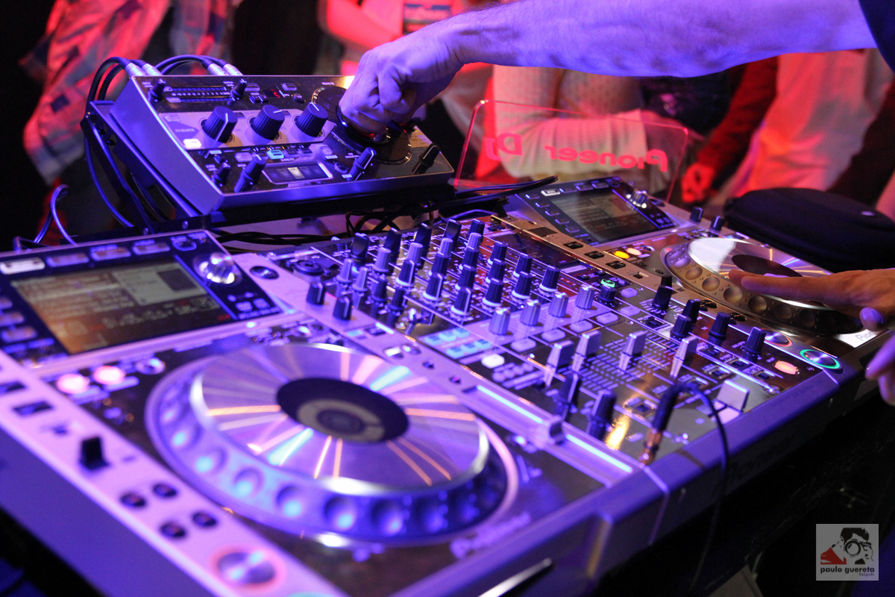
Tune for accuracy
Implicit measures (play with these parameters and pick the one that gives best accuracy on train and test sets)
Interaction Depth
Sub-sampling
Learning rate or Shrinkage
Early Stopping
03

Slide 26


Interaction Depth
• Regression
–No interaction -> y=f(x1,x2,x3…).
–Binary interactions; y=f(x1x2,x2x3,…)
–Ternary interactions -> y=f(x1x2x3…)
• Decision trees
–Interactions are naturally included as the depth.
Tree stump: A special case of decision tree with only one split (i.e a tree with two terminal nodes)
Small trees and lower interaction depths provide accurate results
03

Slide 27
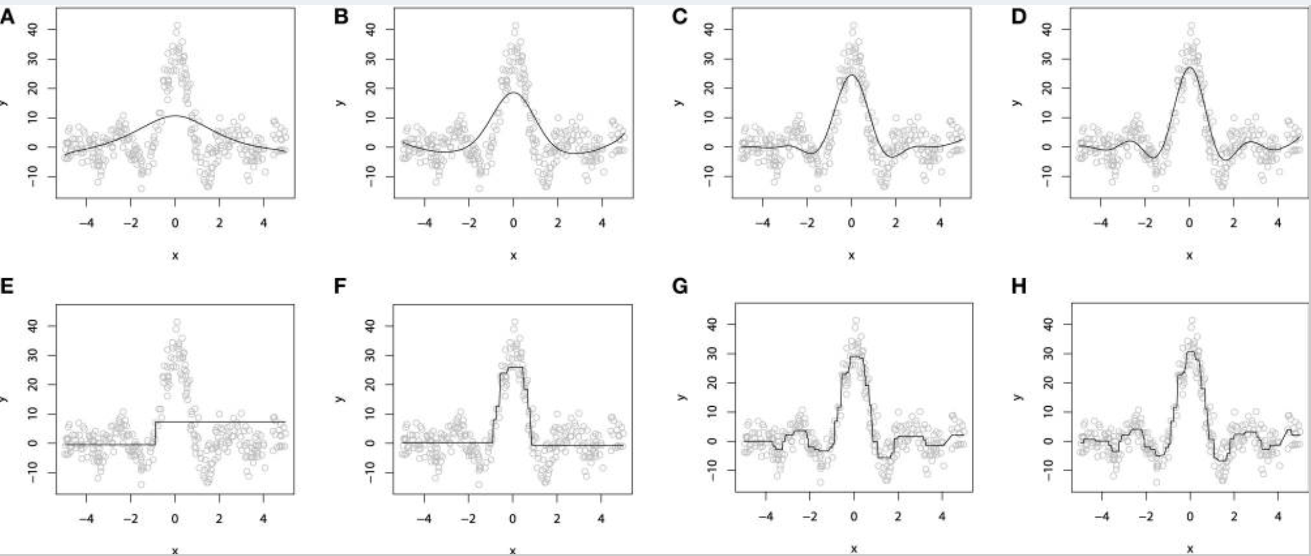
Interaction Depth
03

Slide 28
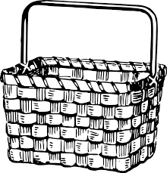
Sub-Sampling
At each learning iteration only a random part of the training data is used to fit a consecutive base-learner.
The subsampling procedure requires a parameter called the “bag fraction.” Bag fraction is a positive value not greater than one, which specifies the ratio of the data to be used at each iteration. For example, bag = 0.1 corresponds to sampling and using only 10% of the data at each iteration.
GBM ensemble will reach the desired accuracy with a larger number of base learners and lower bag than the one with smaller amount of more carefully fitted base-learners with larger bag.
03

Slide 29
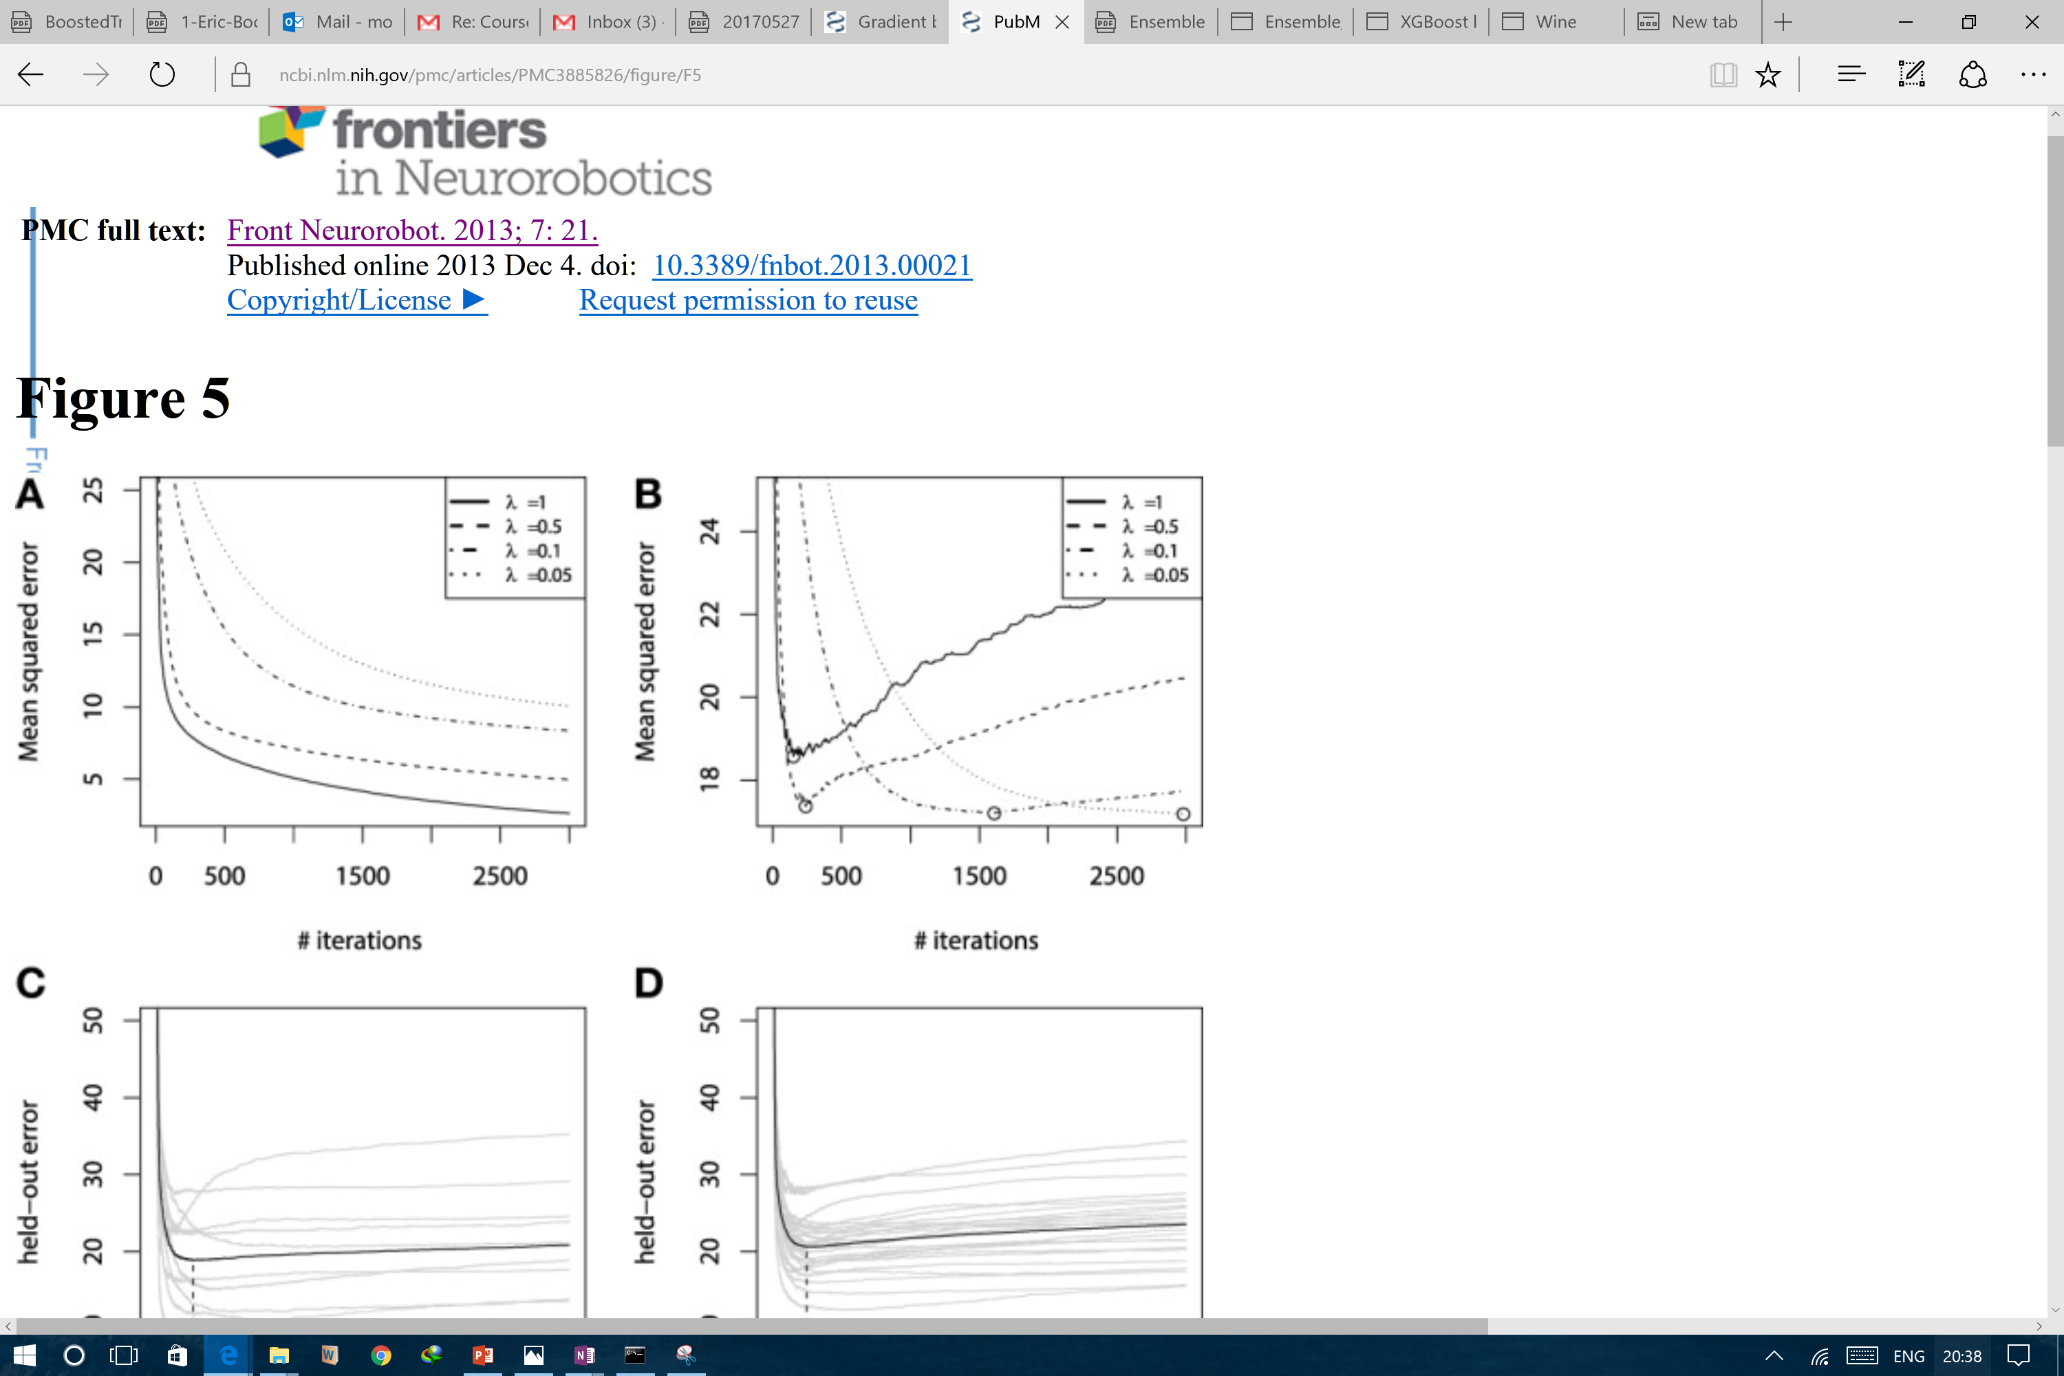

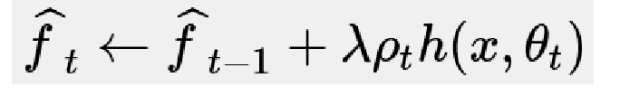
Shrinkage or Learning Parameter
In the context of GBMs, shrinkage is used for reducing the impact of each additional fitted base-learner.
It penalizes the importance of each consecutive iteration. The intuition behind this technique is that it is better to improve a model by taking many small steps than by taking fewer large steps
03

Slide 30
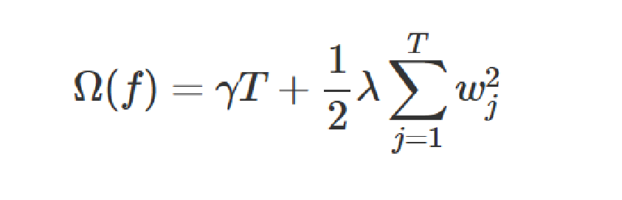
Explicit Regularization
XGBoost defines complexity explicitly.
It is Sparsity-aware
XGBoost is parallelizable
XGBoost can split approximately
03
Notes:
http://matthewemery.ca/Why-Kagglers-Love-XGBoost/

